Slide 1

Public Realm Innovation Lab: Trial plan template
Photos by Heather Macey, Makower Architects

Slide 2
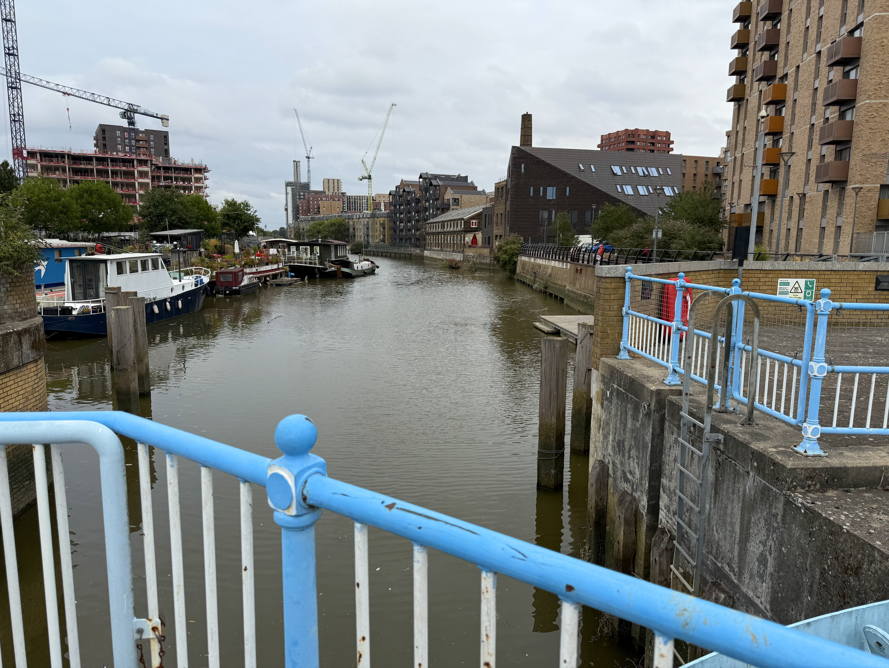
How to use this document
This is a template document for your trial plan. Please stick to one slide per section. We recommend you refer to the application handbook to get further information about the trial sites and identified challenge.

Slide 3
Solution Overview
Please provide:
Company name
Trial partners if you are applying as a consortium
A brief overview of your solution. You are welcome to use images if that helps.

Slide 4
Trial summary
Please provide a brief summary of your trial including what you hope to learn/ demonstrate over the 3 months and how it links to the trial challenge of helping children and young people to achieve a healthy weight by making public spaces more inclusive, inviting and connected

Slide 5
Trial site/s and audience
Please let us know:
Which site/s you wish to trial at in the River Roding Health Corridor and why
Your target audience for the trial

Slide 6
Trial inputs
Describe what inputs you require for your trial to be a success. Including, but not limited to: data, equipment, access, expertise, deployment support, integrations, legal considerations.

Slide 7
Key trial activities and timeline
Please provide us with your proposed timeline for your trial and associated activities/ milestones

Slide 8
Trial participants
Please outline how you plan to recruit and involve end users/ the local community during your trial

Slide 9
Trial impact
Please provide a summary of the anticipated impact of this trial including your success criteria.

